Slide 1
Outlook for the US Economy Over the Coming Year
Prof. Steven Kyle
Cornell University
March 2015

Slide 2
Grading My Predictions from Last Year
Most economists are taught to avoid naming both a number and a date
I do it anyway every year and post the results on my website
How did I do last time?

Slide 3
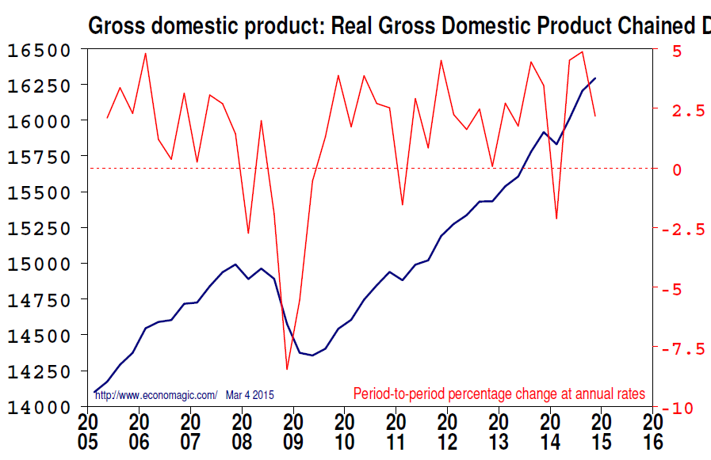
My forecast: “3% or a bit less if Europe has a serious crisis”

Slide 4
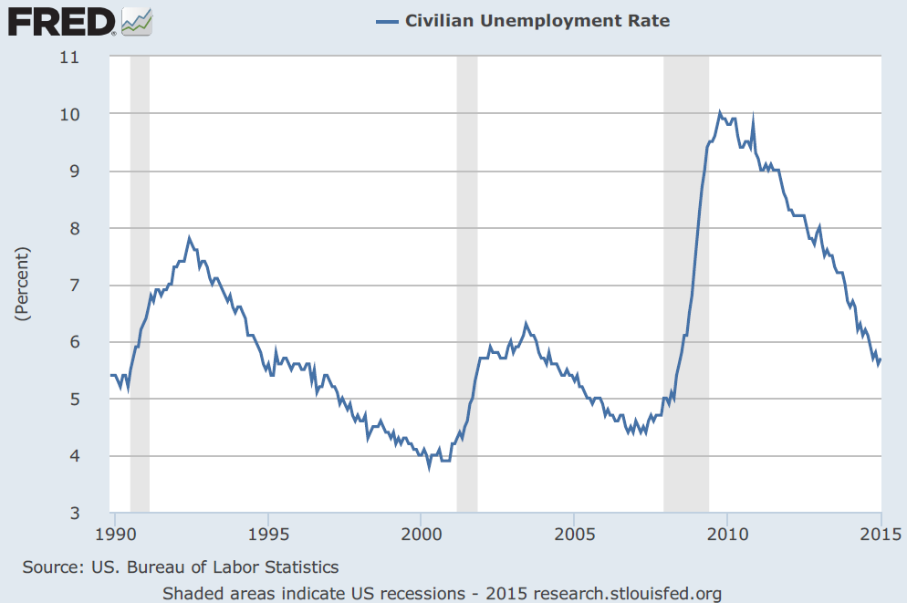
My forecast: “ … mid 6% range”

Slide 5
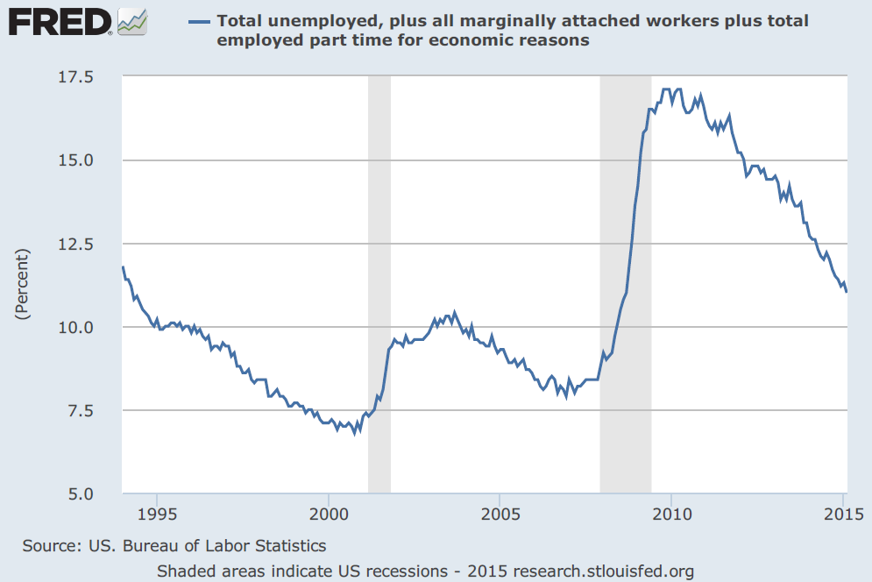
Part timers & discouraged workers also down

Slide 6
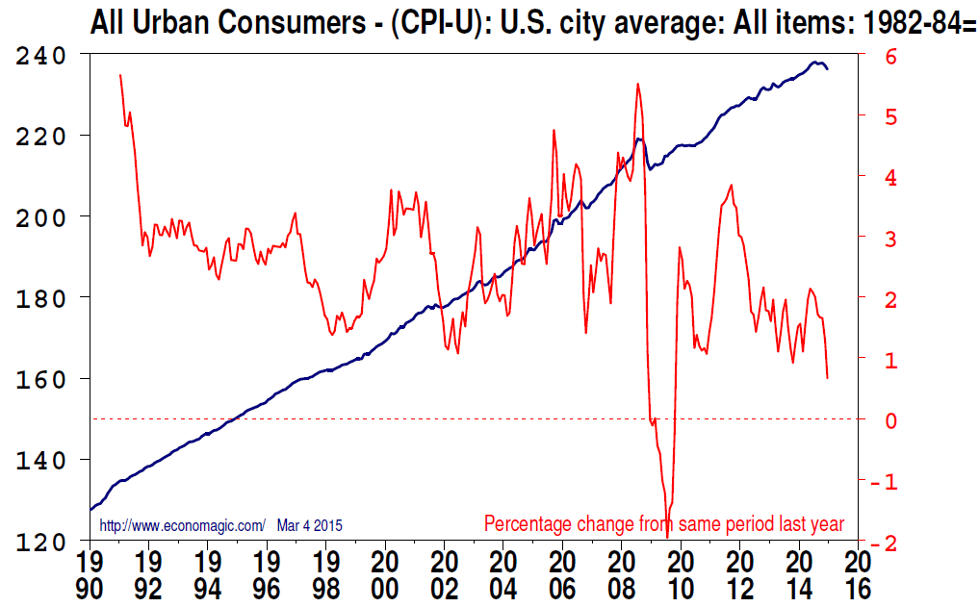
My forecast: “inflation not a worry”

Slide 7
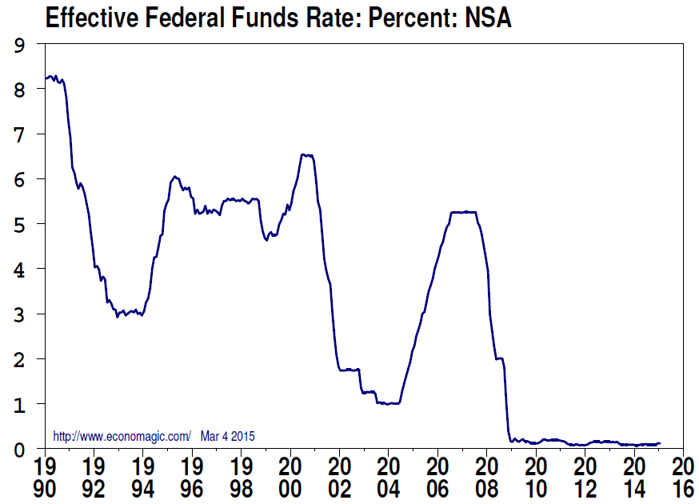
My forecast: “Near zero”

Slide 8
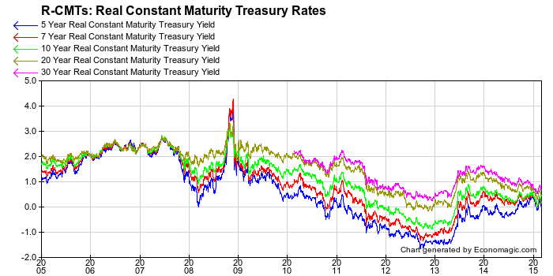
Real Rates Low Across the Board

Slide 10
Housing Market
It was the source of the mayhem in 2008-09
Continues to gradually stage a comeback
Real estate a slow moving market at best of times

Slide 11
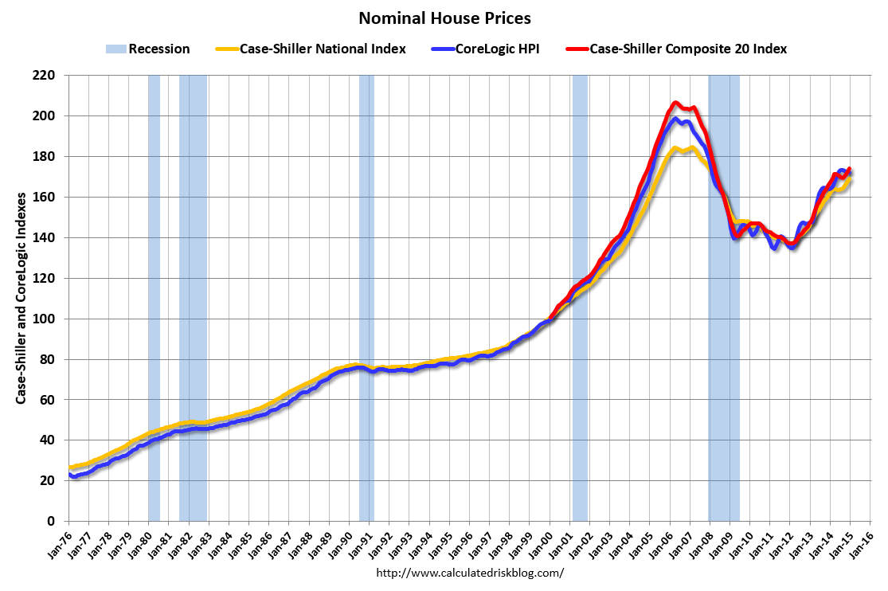

Slide 12
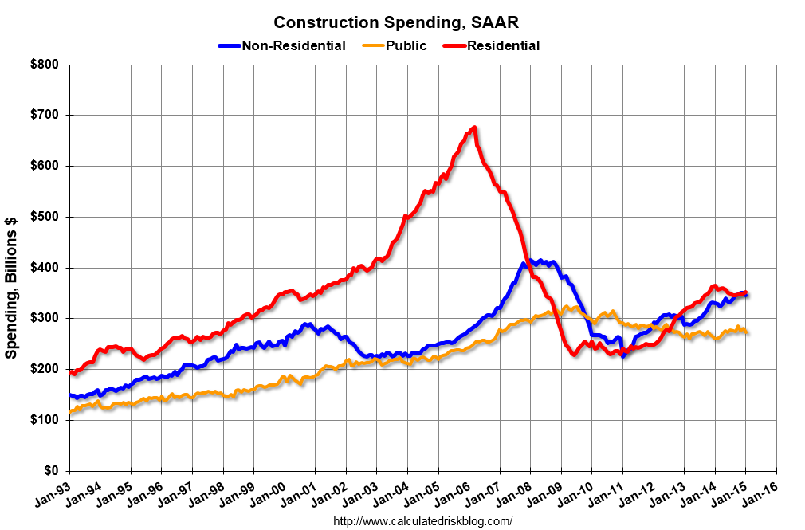

Slide 13
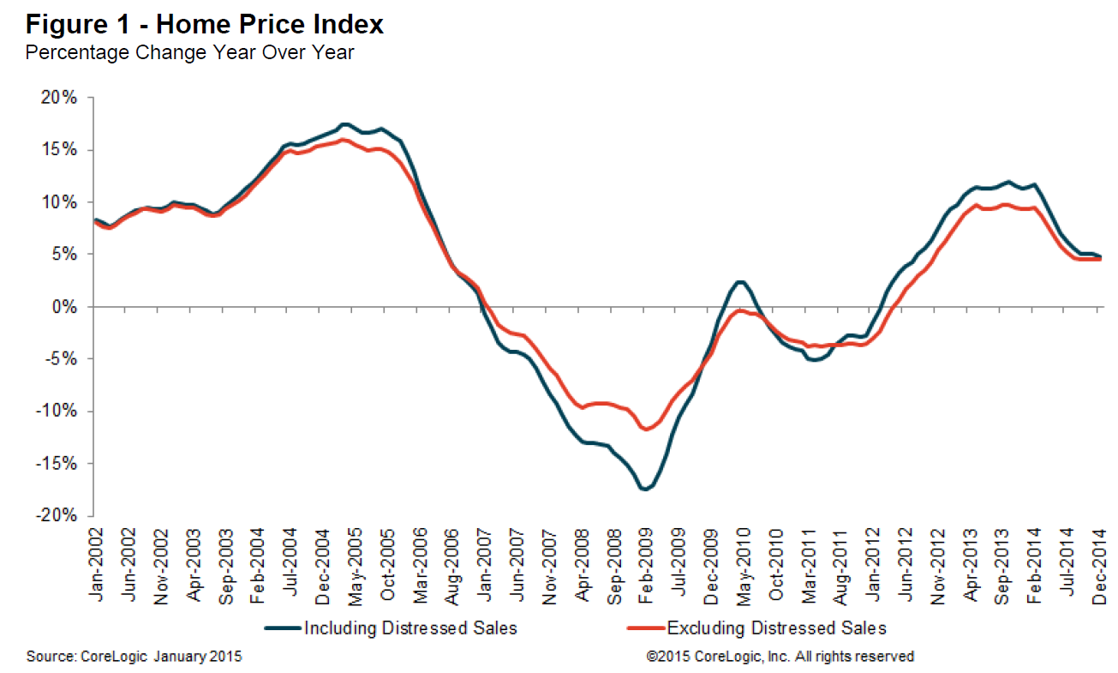

Slide 14
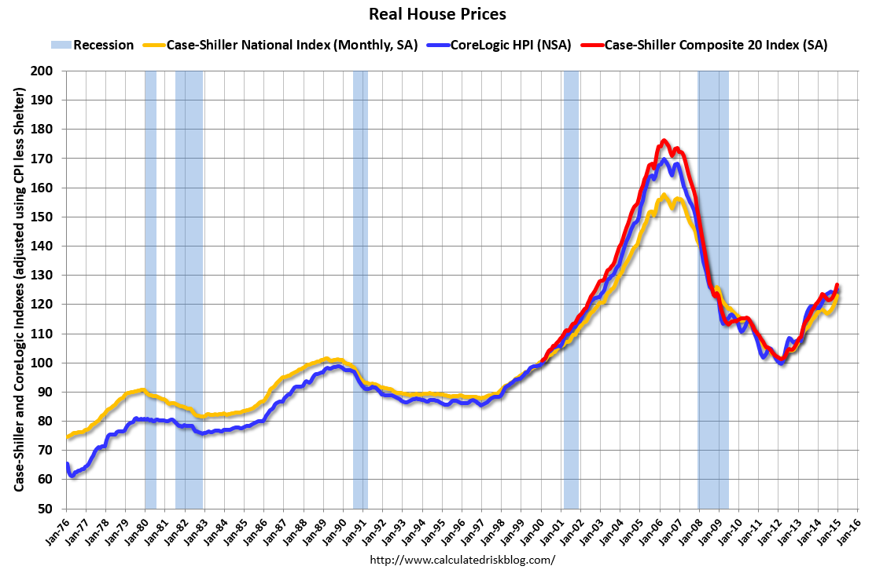

Slide 15
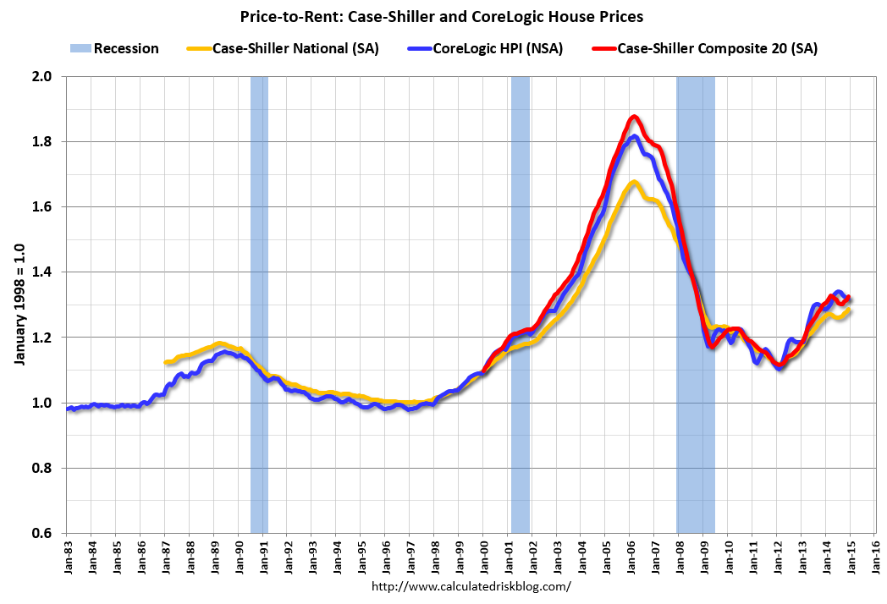

Slide 16
Where are we now in the business cycle?
Still on the upswing though still more gradual than we might like
Coincident and Leading Indicators still in the green

Slide 17
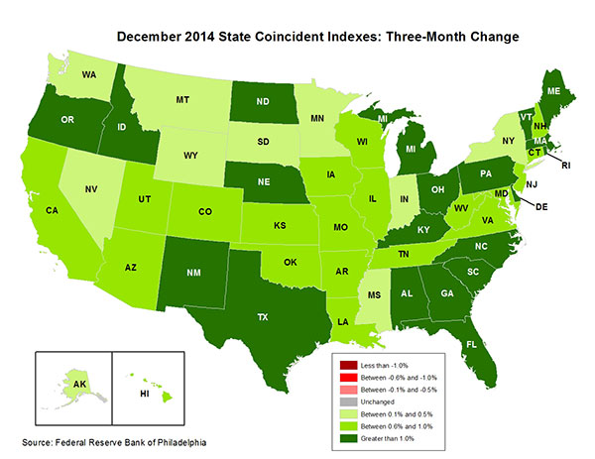

Slide 18
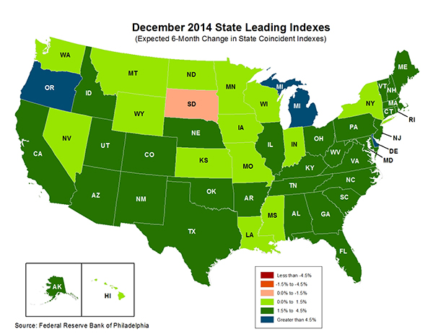

Slide 19
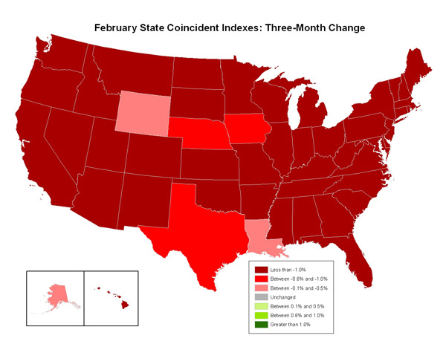
February 2009

Slide 20
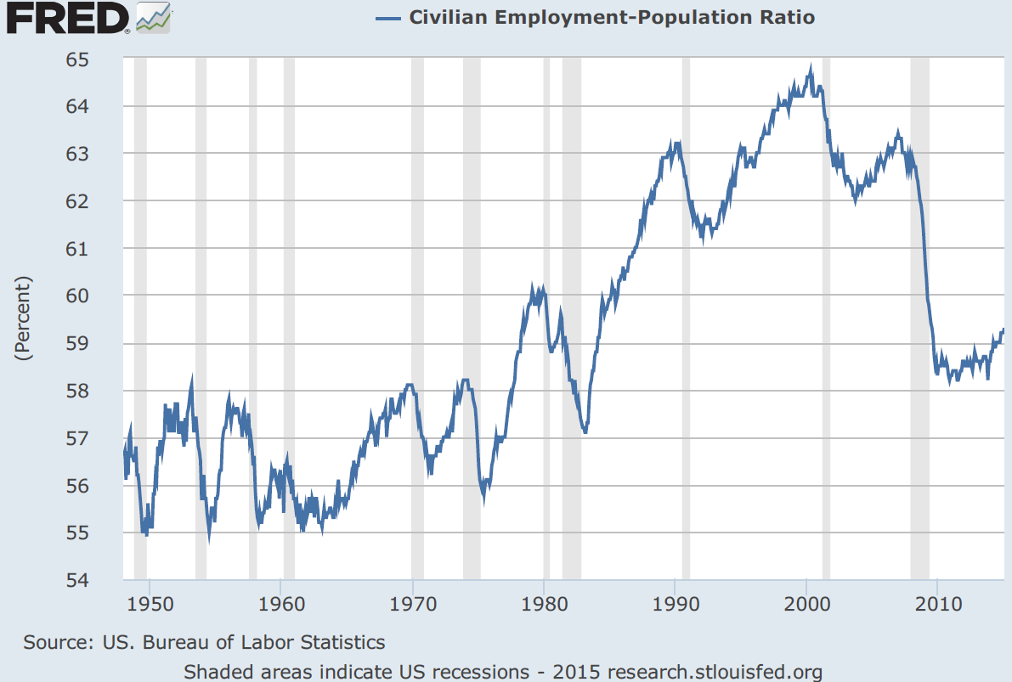
Still Lots of Slack in Labor Market

Slide 21
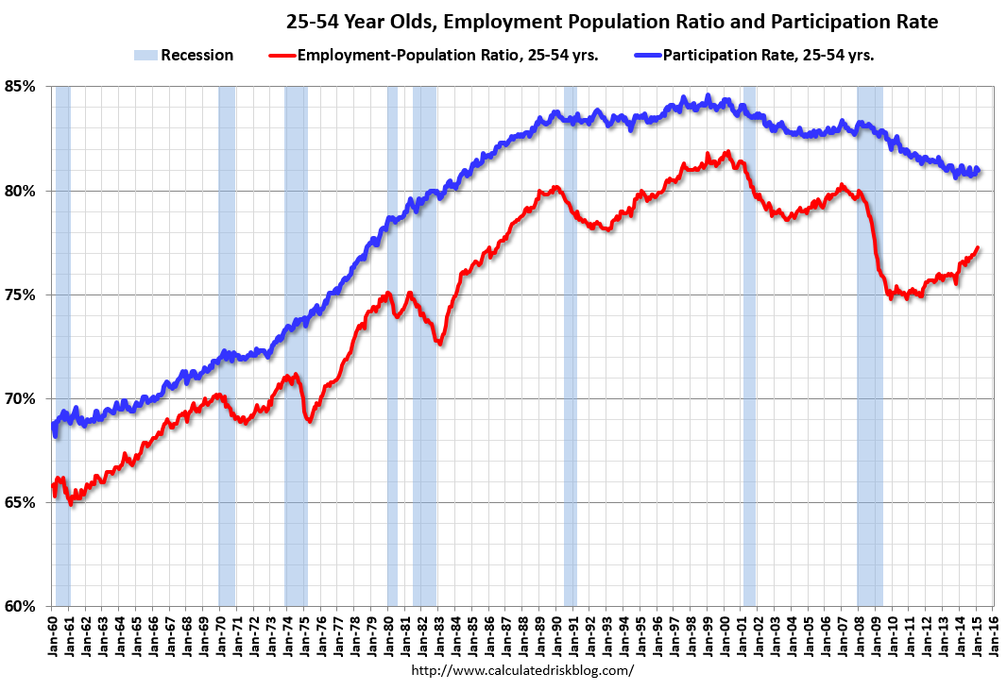
Labor Market for Prime Age Groups Seeing Demographic Change

Slide 22
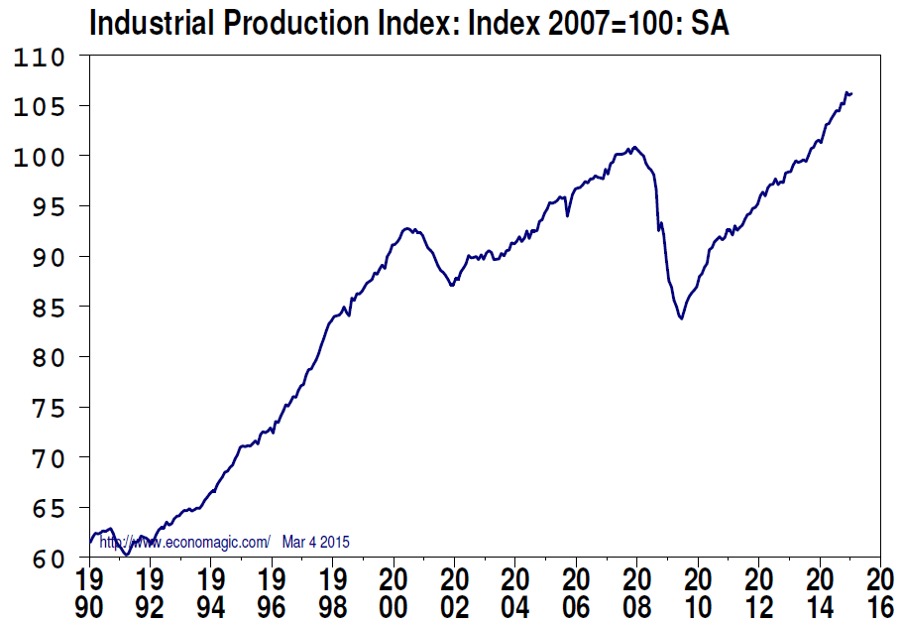
Industrial Production Higher than Previous Peak …

Slide 23
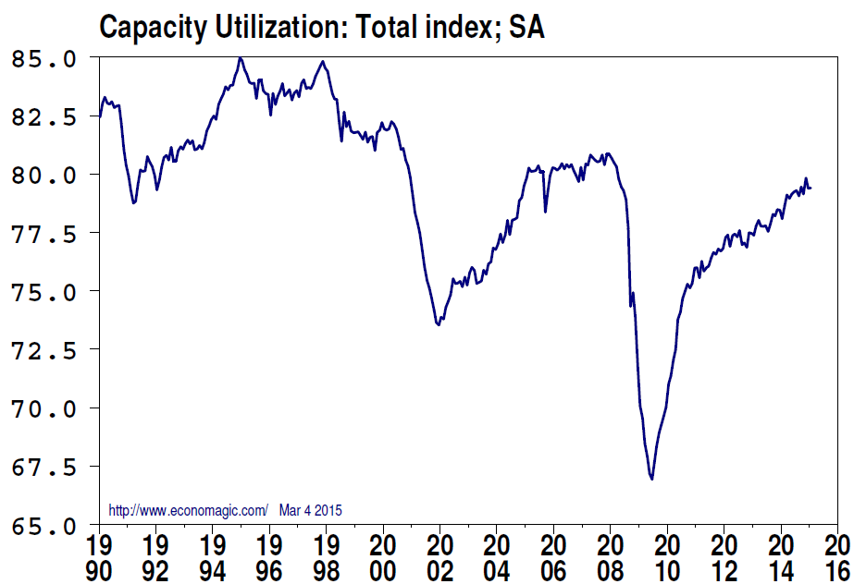
… but Capacity Utilization Still Below 80%

Slide 24
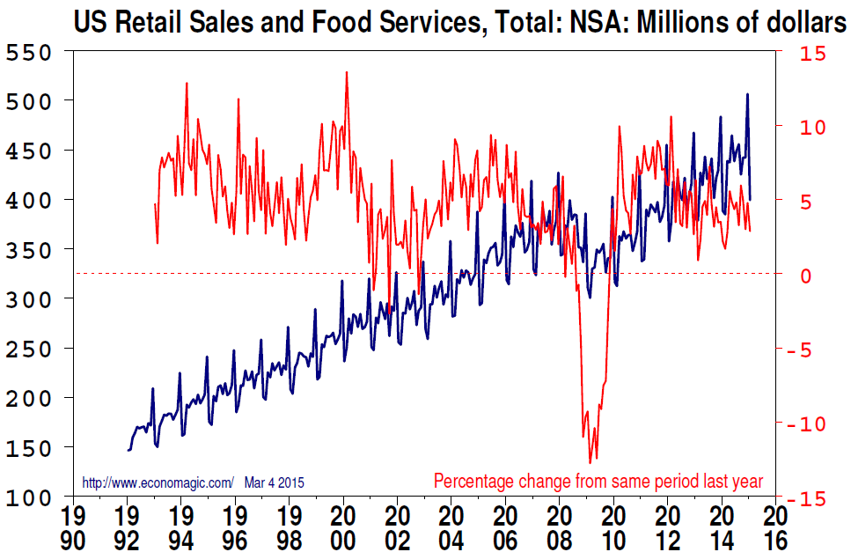
Consumer Spending Still Rising at Trend Rate

Slide 25
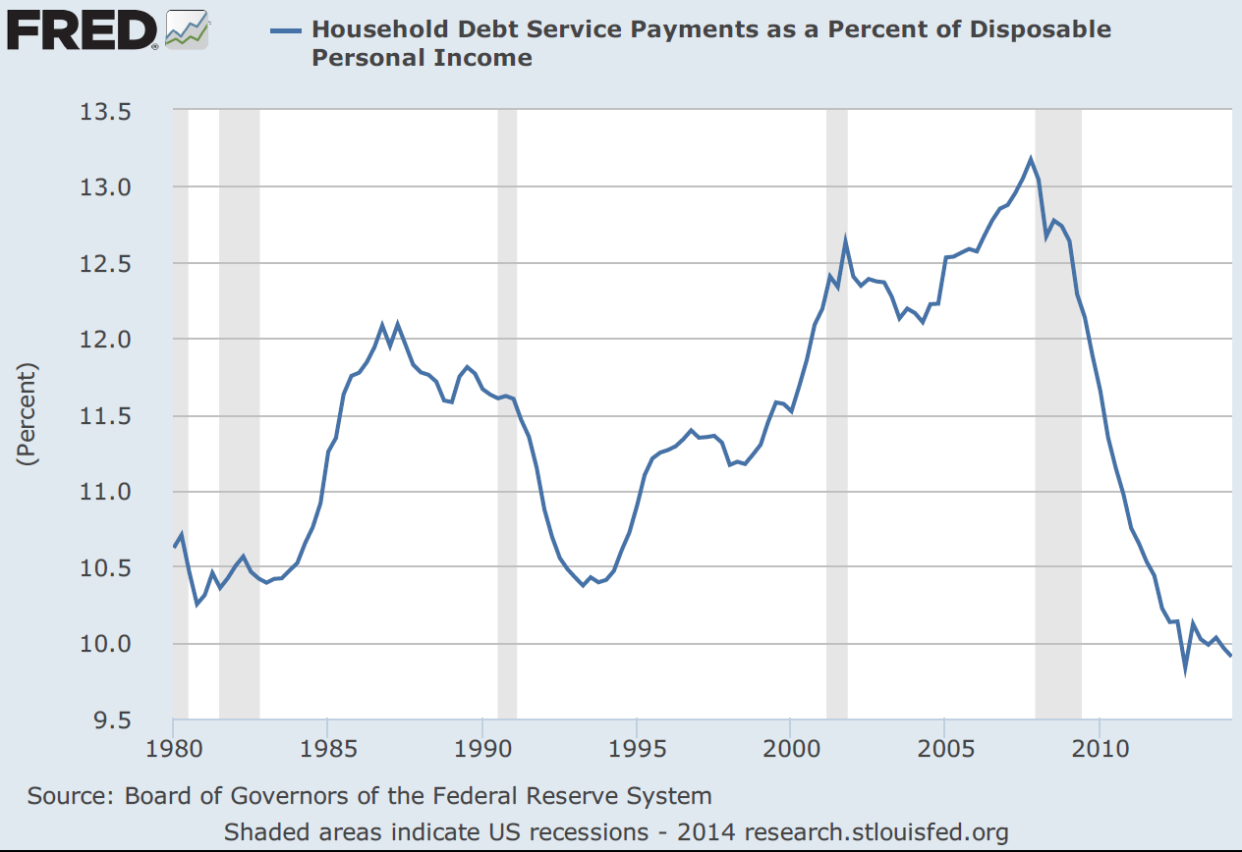
Household Debt Back to “Normal” levels ***

Slide 26
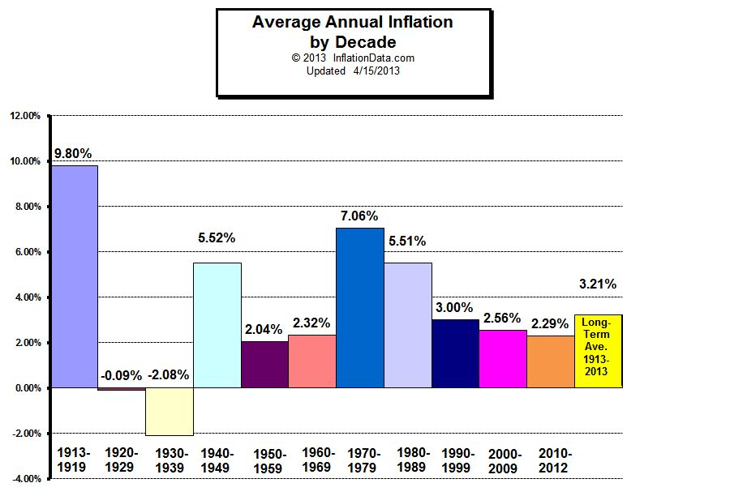
Inflation Still Low by Historical Standards

Slide 27
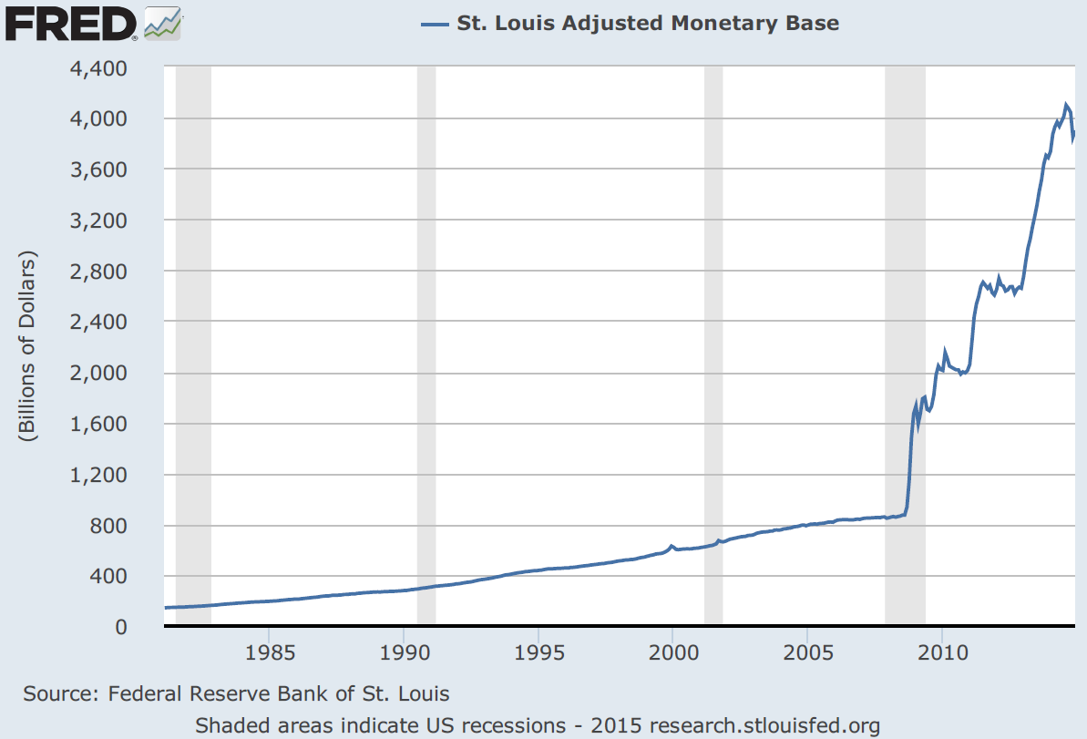
Don’t Worry About This Scary Chart! Really!

Slide 28
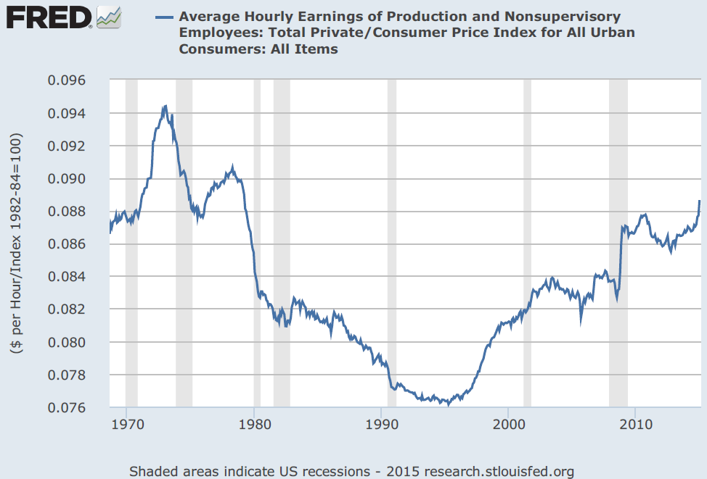
Still Not Much Wage Pressure

Slide 29
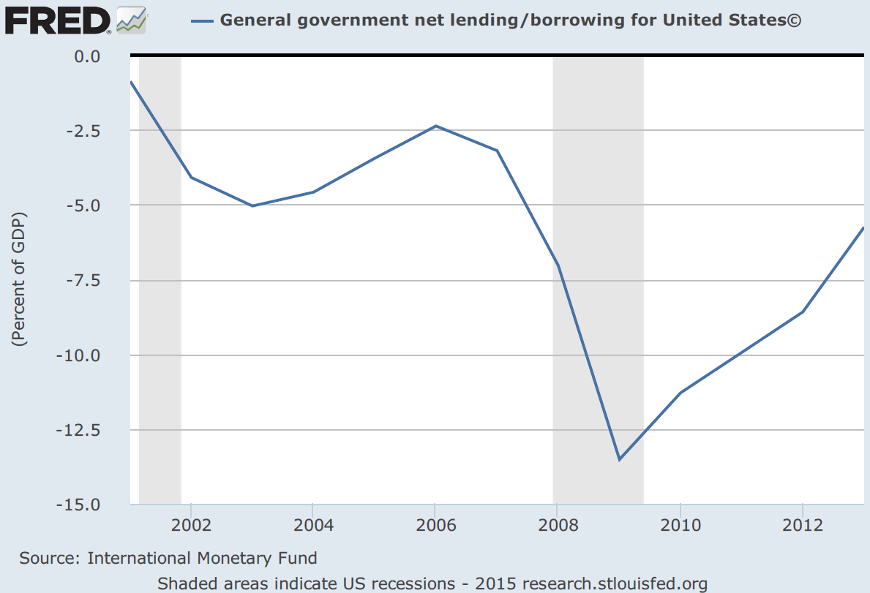
Fiscal Policy Continues to Contract

Slide 30
Europe the Biggest Wild Card
Most recent Greece agreement not really an agreement
Fundamental Issue: They are stuck with one monetary policy for all when some of them really really really need a different policy
My worry: Continuation of policies that generate Great Depression levels of employment discredit centrist politicians

Slide 31
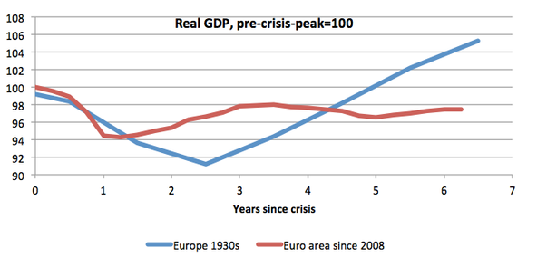

Slide 32
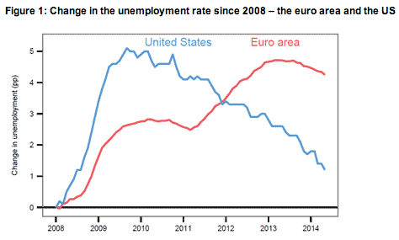

Slide 33
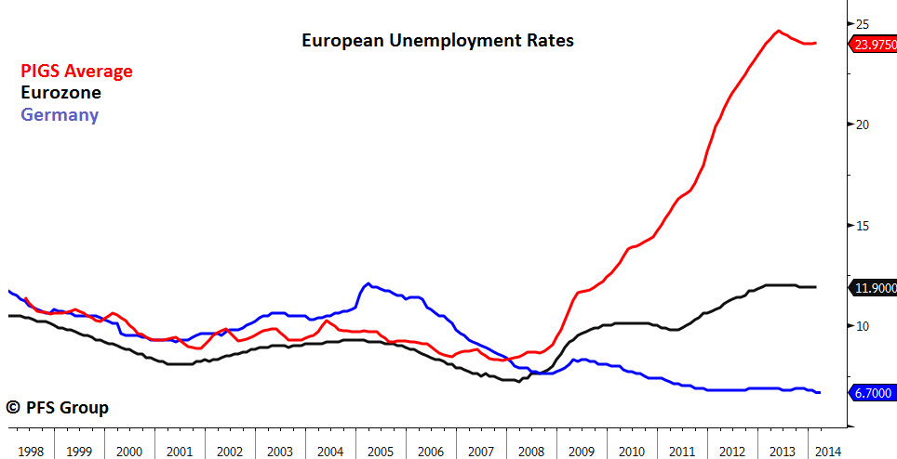

Slide 34
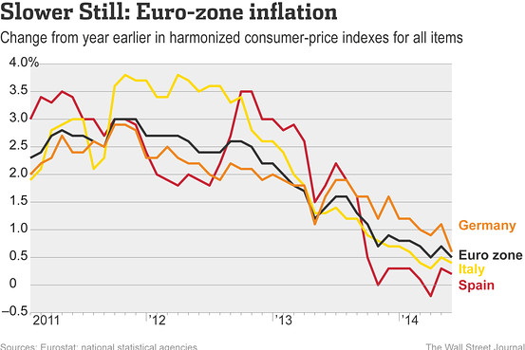

Slide 35
Outlook for Policy
Monetary Policy will be continuation of the present expansionary low interest policy
Fiscal Policy is anyone’s guess. We NEED investment but seem to be getting even more extreme disfunction
Holding economy hostage is no way to govern

Slide 36
Predictions
GDP growth at 3%
Unemployment 5-5.5%
Inflation – Not a worry
Interest rates – 1% or less at short end – Long rates may creep up if wages accelerate
Fiscal Policy? Lets all pray for sanity
Europe - ditto

